Slide 1
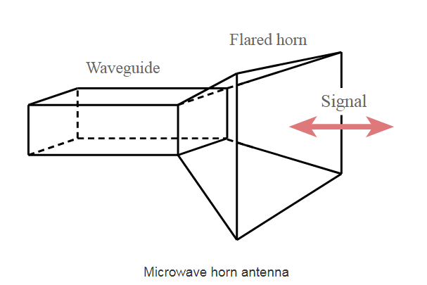
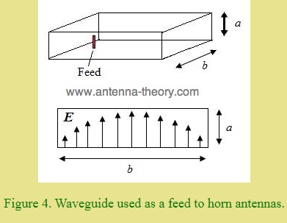
Horn Antenna

Slide 2
Horn Antenna
The energy of the beam when slowly transform into radiation, the losses are reduced and the focusing of the beam improves. A Horn antenna may be considered as a flared out wave guide.
To improve the radiation efficiency and directivity of the beam, the waveguide should be provided with an extended aperture to make the abrupt discontinuity of the wave into a gradual transformation. So that all the energy in the forward direction gets radiated. This can be termed as Flaring. In the horn antenna
the directivity is improved and the diffraction is reduced.

Slide 3
Operation frequency
The operational frequency range of a horn antenna is around 300MHz to 30GHz. This antenna works in UHF and SHF frequency ranges.

Slide 4
Horn Antenna Shape
Horn radiators are constructed in a variety of shapes:
The shape of the horn determines the shape of the field pattern.
The ratio of the horn length to the size of its mouth determines the beam angle and directivity.
In general, the larger the mouth of the horn, the more directive is the field pattern.

Slide 5
Types of Horn Antenna
One dimensional Horn
Sectoral horn (E-plane or H-plane)
Two dimensional Horn
Pyramidal horn (E-plane and H-plane)
All direction Horn
Conical Horn (circular form), exponential horn

Slide 6
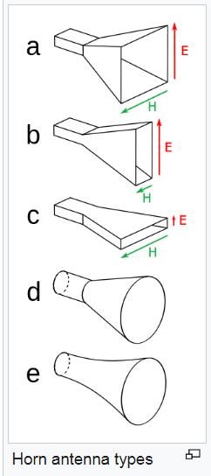
Horn Antenna
a. Pyramidal horn:
This type of horn antenna has flaring on both sides. If flaring is done on both the E & H walls of a rectangular waveguide, then pyramidal horn antenna is produced. This antenna has the shape of a truncated pyramid.
b.c. Sectoral horn:
This type of horn antenna, flares out in only one direction. Flaring in the direction of Electric vector produces the sectoral E-plane horn. Similarly, flaring in the direction of Magnetic vector, produces the sectoral H-plane horn.

Slide 7
Horn Antenna
d. Conical horn:
When the walls of a circular wave guide are flared, it is known as a conical horn. This is a logical termination of a circular wave guide.
e. Exponential horn: A horn with curved sides, in which the separation of the sides increases as an exponential function of length. Exponential horns have minimum internal reflections, and almost constant impedance and other characteristics over a wide frequency range. They are used in applications requiring high performance, such as feed horns for communication satellite antennas and radio telescopes.

Slide 8
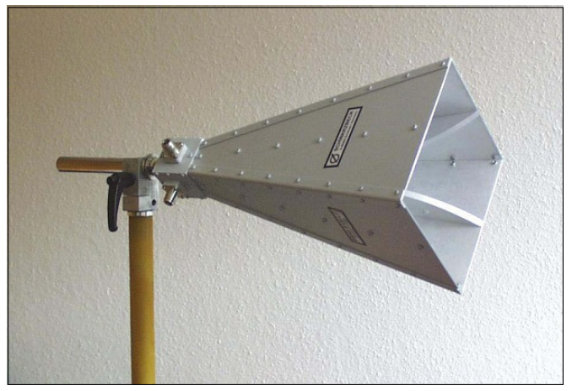
Pyramidal Horn Antenna

Slide 9
Difference Between Sectoral (E, H plane) and Pyramidal Horn
E-plane: Radiation pattern exhibit side lobes.
H-plane: Radiation pattern exhibit no side lobes. It is more popular.
Pyramidal: Radiation pattern exhibit in E-plane and H-plane (2 direction), therefore improve directivity..

Slide 10
Flaring/Flare Angle
Flaring helps to match the antenna impedance with the free space impedance for better radiation. It avoids standing wave ratio and provides greater directivity and narrower beam width.
Flare angle, Φ of the horn antenna is an important factor to be considered. If this is too small, then the resulting wave will be spherical instead of plane and the radiated beam will not be directive. Hence, the flare angle should have an optimum value and is closely related to its length.

Slide 11
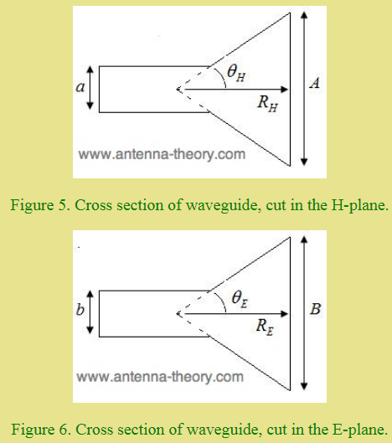
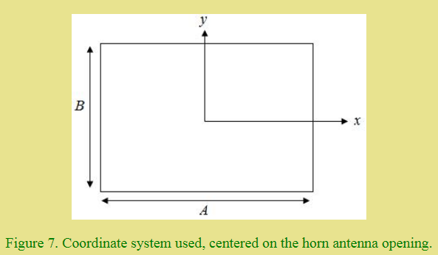
Parameters for Radiation Pattern

Slide 12
Parameters for Radiation Pattern
The radiation pattern of a horn antenna will depend on B and A (the dimensions of the horn at the opening) and R (the length of the horn, which also affects the flare angles of the horn), along with b and a (the dimensions of the waveguide). The flare angles depend on the height, width and length of the horn antenna.
Figure 7 shows the coordinate system which is centered at the opening of the horn), the radiation will be maximum in the +z-direction (out of the screen).

Slide 13
Radiation Pattern
The radiation pattern of a horn antenna is a spherical wave front. The flaring keeps the beam focused. The radiated beam has high directivity.

Slide 14
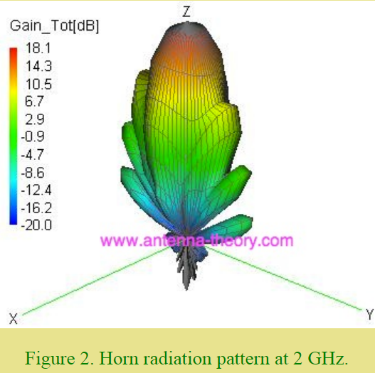
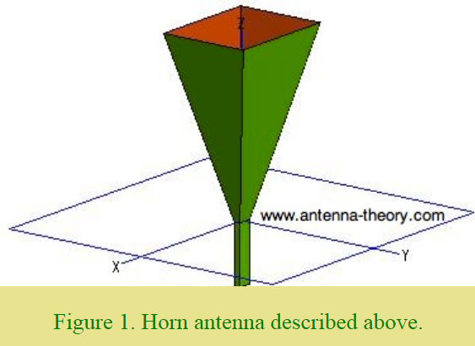

Slide 15
Advantage-Disadvantage-Application
Advantages
Small minor lobes are formed
Impedance matching is good
Greater directivity
Narrower beam width
Standing waves are avoided
Disadvantages
Designing of flare angle, decides the directivity
Flare angle and length of the flare should not be very small
Applications
Used for astronomical studies
Used in microwave applications

Slide 16
Features
Horn antennas are very popular at UHF (300 MHz-3GHz) and higher frequencies.
It has often directional radiation pattern with a high antenna gain (25 dB), typically 10-20 dB.
The input impedance is slowly varying over a wide frequency range i.e. it has wide impedance bandwidth
Gain of horn antenna often increases as the frequency of operation is increased.
Size of horn aperture is always measured in wavelengths, a higher frequency has a smaller wavelength.
Horn antennas have very little loss so the directivity of a horn is roughly equal to its gain.

Slide 17
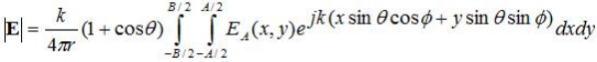
Field Distribution (Equation)
Electric field in the far field shows linear polarization and the magnitude is

Slide 18
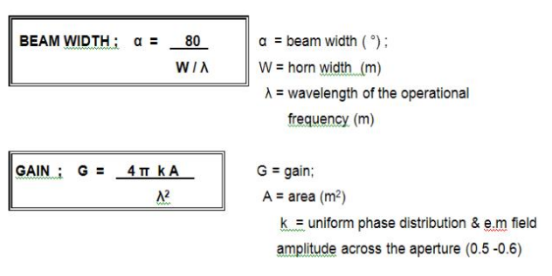
Equation (Beam Width and Gain)

